Slide 1














Project Check-in
Presented by :
Aditya Kumar
Siddharth Verma

Slide 2
Analysis of different types of Solar panels and their power output and reqiurement.
01.
Objectives
02.
"Energy Consumption Across Occupancy Levels,
Room Size vs Efficiency”
03.
Policy recommandation

Slide 3
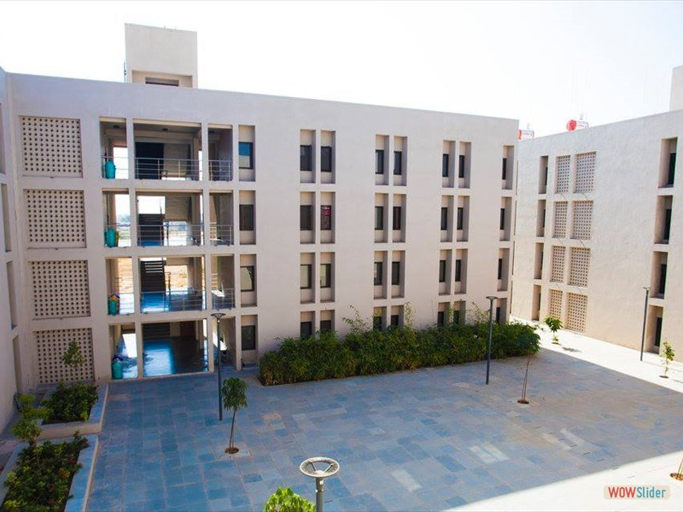
Hostels at our Campus
The rooftop area of hostels at our campus ranges from 3800 sq. ft to 4200 sq. ft.
Based on the calculations if we can install solar panels to a maximum capacity, we can produce roughly 290kWh per day on a good sunny day.
On a rainy day, the output might drop to 50% or more, but the area of Gandhinagar receives almost 270-300 days of good sunlight every year.

Slide 4
Hostels at our Campus
So if we can increase out solar output we can increase our solar output for hostels to a large extent as currently we are producing on average 2500 kWh per month which can be increased to 3 times the current production.

Slide 5
Hostels at our Campus
In Gujarat the rate at which electricity is sold to grid is Rs 2.25/unit.
Based on that we can upto Rs 191,250 every year for every hostel. And if we do the same for every hostel then we can same approx 23 Lakh every year in the hostel energy bill alone. This figure can be doubled if we include the Academic area as well.

Slide 6
Hostels at our Campus
The average cost of a solar grid of 75kW to 100 kW is around 30 to 40 lakh, and the life of the solar grids are 25 years and that can be recovered in approx. 17 years.

Slide 7
Hostel Room Distribution
Hostel Name | Single Rooms | Double Rooms | Triple Rooms
AIBAAN | 140 | 54 | 0
BEAUKI | 109 | 27 | 0
CHIMAIR | 99 | 41 | 0
DUVEN | 181 | 4 | 0
EMIET | 141 | 44 | 0
FIRPEAL | 210 | 0 | 0
GRIWIKSH | 13 | 0 | 36
HIQOM | 69 | 0 | 76
IJOKHA | 56 | 0 | 49
JURQIA | 48 | 0 | 60
KYZEEL | 76 | 0 | 88
LEKHAAG | 35 | 0 | 63
Total Capacity | 1177 | 170 | 372
Total Occupancy | 1170 | 340 | 1116

Slide 8
Hostel | Single Rooms | Double Rooms After Conversion | Power Saved (kWh)
AIBAAN | 140 | 70 | 793.8
BEAUKI | 109 | 54 | 639.25
CHIMAIR | 99 | 49 | 587.55
DUVEN | 181 | 90 | 1047.49
EMIET | 141 | 70 | 822.69
FIRPEAL | 210 | 105 | 1191.7
GRIWIKSH | 13 | 6 | 96.93
HIQOM | 69 | 34 | 412.65
IJOKHA | 56 | 28 | 317.12
JURQIA | 48 | 24 | 271.36
KYZEEL | 76 | 38 | 432.72
LEKHAAG | 35 | 17 | 220.67
Power Savings
by Converting Single
Rooms to Double Rooms
Daily energy consumption for single
room ≈ 28.89 kWh
Daily energy consumption for double
room ≈ 46.44 kWh
Per student daily
consumption ≈ 23.22 kWh
The total power saved across all
hostels by converting
all single rooms into double rooms
would be
approximately 6523.33 kWh.

Slide 9
Hostel | Single Rooms | Triple Rooms After Conversion | Power Saved (kWh)
AIBAAN | 140 | 46 | 1606.32
BEAUKI | 109 | 36 | 1239.73
CHIMAIR | 99 | 33 | 1063.67
DUVEN | 181 | 60 | 2182.92
EMIET | 141 | 47 | 1533.47
FIRPEAL | 210 | 70 | 2303.7
GRIWIKSH | 13 | 4 | 109.92
HIQOM | 69 | 23 | 317.67
IJOKHA | 56 | 18 | 309.84
JURQIA | 48 | 16 | 271.36
KYZEEL | 76 | 25 | 366.09
LEKHAAG | 35 | 11 | 142.54
Power Savings
by Converting Single
Rooms to Triple Rooms
Daily energy consumption for triple
room ≈ 52.98 kWh
Per student daily
consumption ≈ 17.66 kWh
The total power saved across all
hostels by converting
all single rooms into triple rooms
would be
approximately 11647.25 kWh.

Slide 10
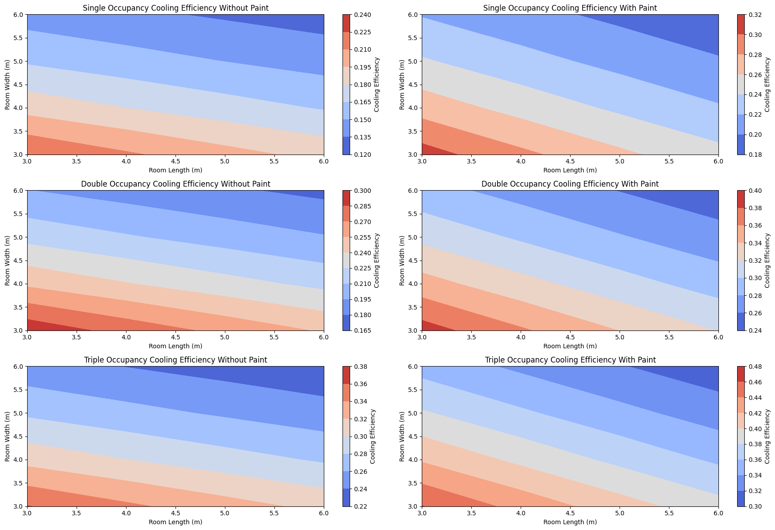

Slide 11
Policies to Save Energy
Conversion Strategy: Implement a gradual conversion strategy to convert single rooms into double or triple rooms based on demand and feasibility. This can help optimize room occupancy and reduce energy consumption per student.
Incentives for Shared Rooms: Provide incentives for students to opt for shared rooms, such as reduced room fees or priority in room selection. This can encourage students to share rooms, leading to better utilization of existing infrastructure.
Use of Reflective Paint: Encourage the use of reflective paint on walls facing the sun to reduce heat absorption and improve cooling efficiency. The simulation shows that reflective paint can significantly reduce the heat transfer rate through walls, leading to better cooling efficiency.
Increasing the solar panels at our campus for green and clean energy.

Slide 12


THANK YOU!

Slide 13
More sunlight = more energy
Minimize shading. It may seem obvious, but if there's shade blocking the sun, your solar panel output will be low. You may need to cut back some trees to get the most out of your panels.
Orient your panels for maximum production. In general, south-facing panels at a 30-degree angle will produce the most electricity. But east- and west-facing panels usually produce plenty of energy. The ideal angle for your panels depends on your latitude. Angles between 15-40 degrees are usually fine.
Southwest or southeast: 8% less efficient West or east: 15% less efficient North: 30% less efficient
Maximize your solar panels' hours of sunlight. During the summer, your solar panels will produce more electricity than during the winter and some areas get more hours of sunlight than others. Roofs with a lot of sunlight hours have high production ratios, which means solar panels produce a lot of energy (in kWh) relative tooutput (in watts).
For a state like gujarat angle between 35 to 40 should be ideal as the altitude is not great.

Slide 14
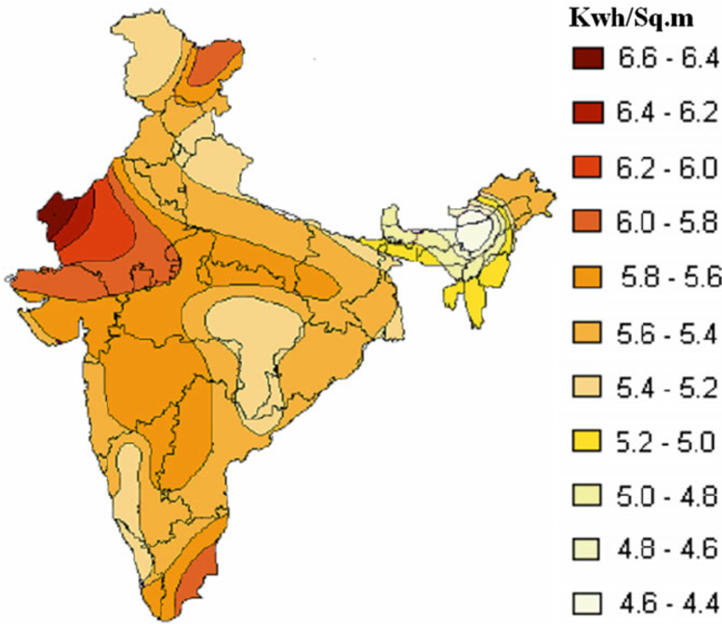
Solar irradiance in India
Most solar panels have cells that can convert 17-22% of the sunlight that hits them into usable solar energy.
Total Power Output = Total Area x Solar Irradiance x Conversion Efficiency
We know the required Total Output Power is 1000 Watts (10 panels x 100 Watts), the Solar Irradiance for a surface perpendicular to the sun’s rays at sea level on a clear day is about 1000 Watt/m2 and the Conversion Efficiency is 18%. Plugging these number in the above equation we get:
1000 Watts = Total Area x 1000 Watts/m2 x 0.18
or
Total Area = 1000/180 = 5.56 m2
Gujarat is a solar energy-resource- rich state and receives solar radiation in the range of 5.5-6 kWh. m^2/day for more than 300 days of the year. That means Gujarat have a lot of potential when it comes to generating solar power.

Slide 15
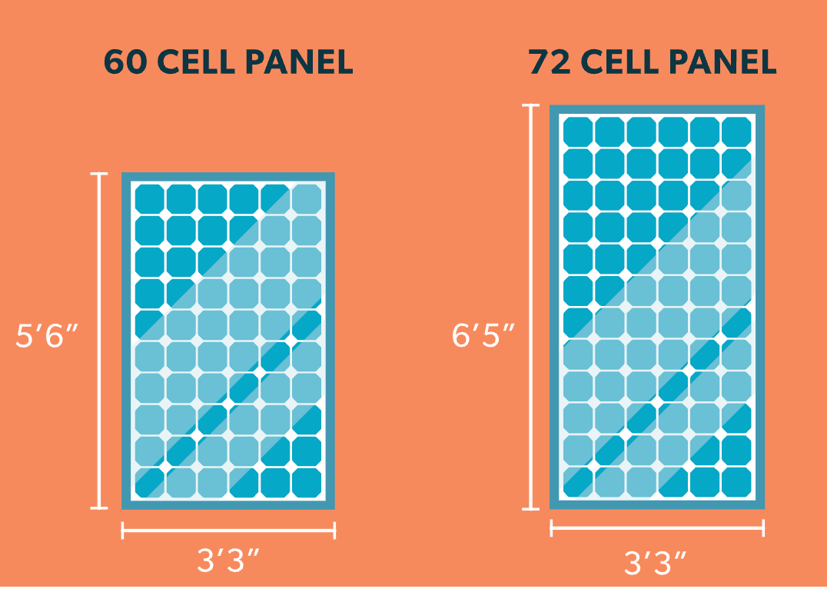
Different variant of Solar panels in India
An individual solar cell is a 6” x 6” square. 60-cell panels are laid out in a 6×10 grid. 72-cell panels are laid out in a 6×12 grid, making them about a foot taller.
60-cell panels: 39″ x 66″ (3.25 feet x 5.5 feet)
72-cell panels: 39″ x 77″ (3.25 feet x 6.42 feet)
Configuration | Width | Height | Depth
60-cell | 39″ | 66″ | 1.3 – 1.6″
72-cell | 36″ | 77″ | 1.3 – 1.6″
96-cell | 41.5″ | 62.6″ | 1.38″

Slide 16
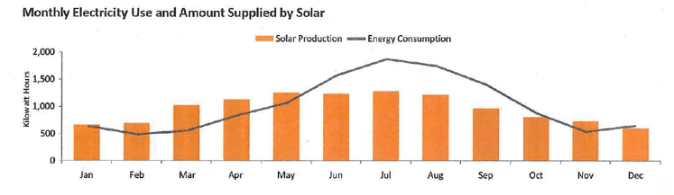
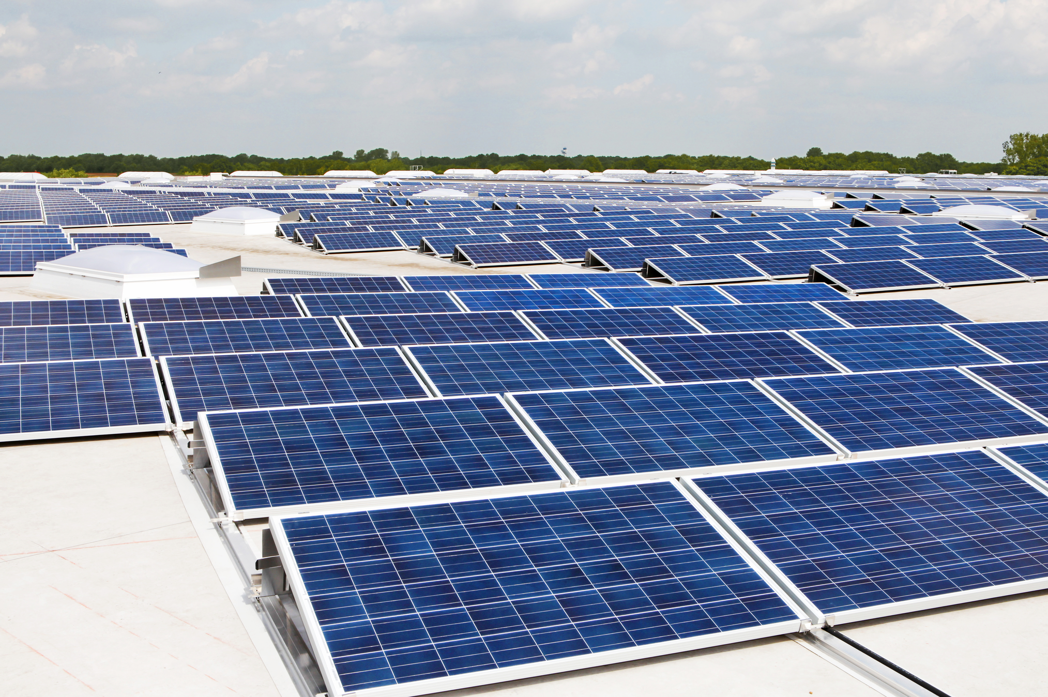

Slide 17
Highest output home solar panels
Brand | Wattage | Efficiency | Size | Wattage Per Square Foot | Solar Panel Model
SunPower | 440 W | 22.8% | 6.1 X 3.4 ft | 21.2 | SPR-M440-H
Q CELLS | 400 W | 22.5% | 5.6 x 3.7 ft | 20.9 | Q.TRON BLK M-G2+ 440W
REC Group | 430 W | 22.3% | 5.7 x 3.7 ft | 20.7 | Alpha Pure-R 430 W
Maxeon Solar | 420 W | 22.2% | 5.9 x 3.4 ft | 20.6 | 3 DC Black 420 W
Silfab Solar | 420 W | 21.9% | 6.1 x 3.4 ft | 20.3 | SIL - 420 BG

Slide 18
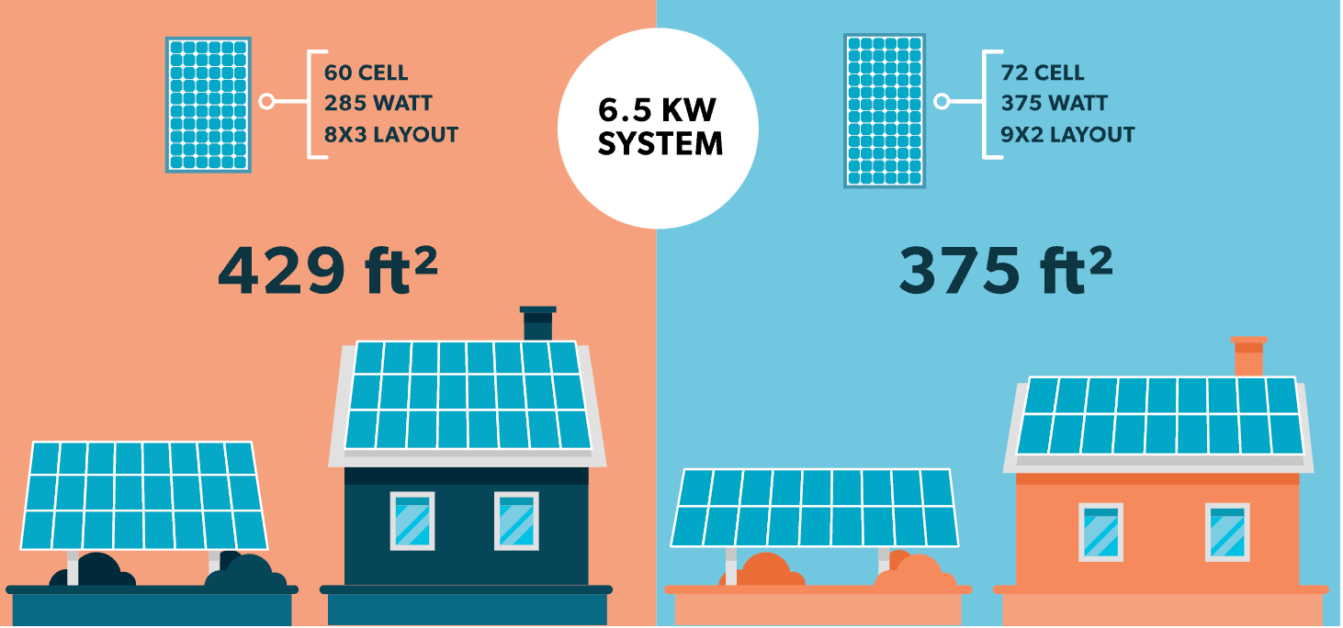
Let’s compare the least efficient panels (285W / 60-cell) to the most efficient (375W / 72 cell) to get a sense for how much space the array might take up:
375W 72-cell panels (9×2 array)
29.25 ft. x 12.83 ft. = 375.38 sq. ft.
285W 60-cell panels (8×3 array)
26 ft. x 16.5 ft. = 429 sq. ft.
6.5 kW (6500-watt) system
The 60-cell solar panels we currently stock range from 285W to 315W, and our stock of 72-cell panels ranges from 335W to 375W. We can figure out approximately how many panels it would take to build a 6.5 kW (6500-watt) system:
6500W / 285W = 22.8 (23 panels)
6500W / 315W = 20.6 (21 panels)
6500W / 340W = 19.1 (20 panels)
6500W / 375W = 17.3 (18 panels)

Slide 19
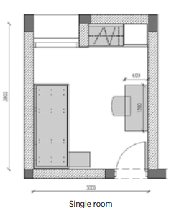
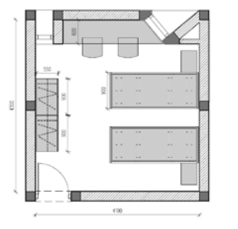
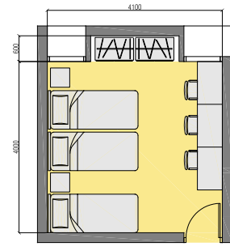
"Energy Consumption Across Occupancy Levels"
Total power consumption (single) = 2735 W
Total power consumption
(Double) = 4380 W
Total power consumption
(Triple) = 5450 W
Per student
consumption = 2735 W
Per student
consumption = 2190 W
Per student
consumption = 1816.67 W

Slide 20
SINGLE OCCUPANCY ROOMS REQUIREMENT
Based on the the 6.5 Watt grid we can calculate the requirement of different systems as well:
A single occupancy room requires 2785 Watts for an individual so based on that we require 160 to 183 sq. ft of area to fulfill the requirements to a large extent in summers.

Slide 21
DOUBLE OCCUPANCY ROOMS REQUIREMENT
Based on the the 6.5 Watt grid we can calculate the requirement of different systems as well:
A single occupancy room requires 2190 Watts for an individual so based on that we require 126 to 145 sq. ft of area to fulfill the requirements to a large extent in summers.

Slide 22
TRIPLE OCCUPANCY ROOMS REQUIREMENT
Based on the the 6.5 Watt grid we can calculate the requirement of different systems as well:
A single occupancy room requires 1816.67 Watts for an individual so based on that we require 105 to 120 sq. ft of area to fulfill the requirements to a large extent in summers.

Slide 23
Occupancy Levels vs Efficiency
Percentage Difference in Per Student Consumption:
Double vs. Single: (2735 - 2190) / 2735 * 100 ≈ 19.96%
Triple vs. Double: (2190 - 1816.67) / 2190 * 100 ≈ 16.99%
Triple vs. Single: (2735 - 1816.67) / 2735 * 100 ≈ 33.60%

Slide 24
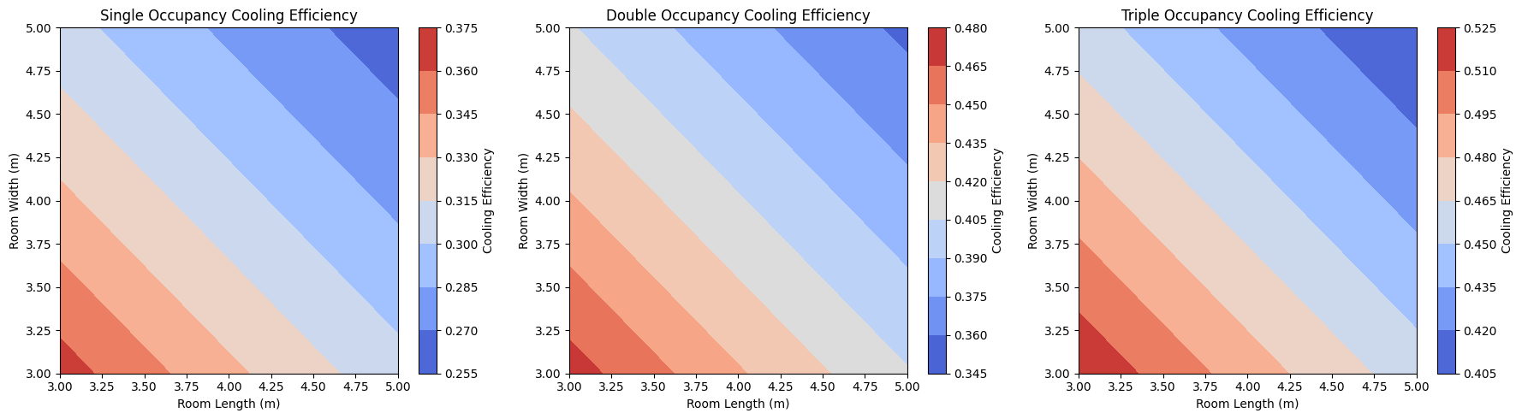
Room Size vs Efficiency

Slide 25
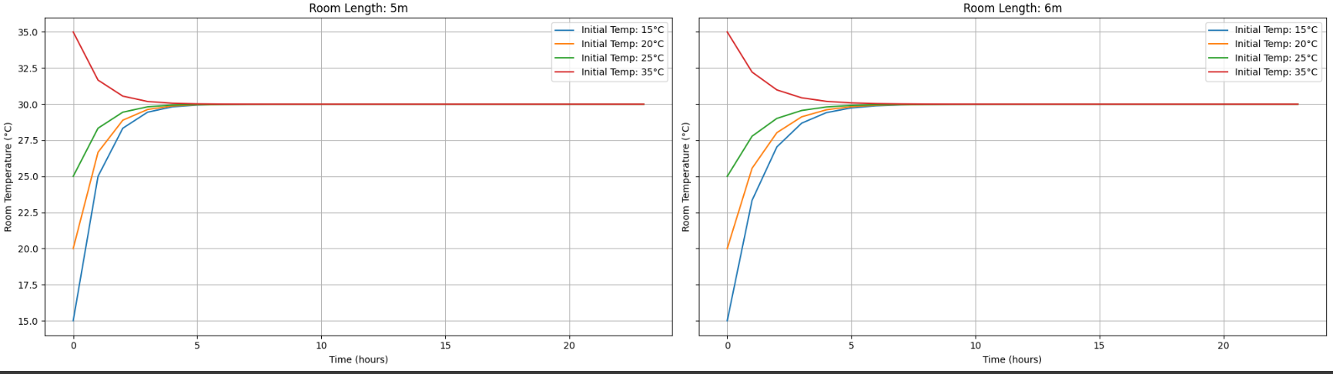
Overall, while larger rooms still tend to have better cooling efficiency for double and triple occupancy scenarios, the difference in efficiency between room sizes is less pronounced compared to single occupancy scenarios due to factors such as increased heat generation and diminishing returns with larger room sizes.

